Slide 1
Script
Implementation

Slide 2
What are we missing?
We already implemented Tx
To make transactions we still need to:
Create/serialize scripts in Script!!!
To validate transactions we need to:
Run the scripts written in Script!!!
Now we will explain how to do this
online.ing.puc.cl

Slide 3
Scripts
Commands
Two types:
OP_CODES
Bytes (data)
online.ing.puc.cl

Slide 4
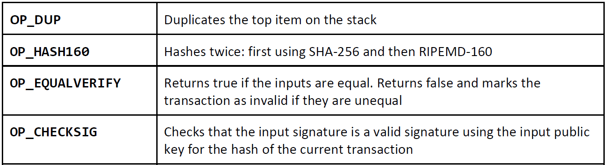
Script
Op codes

Slide 5
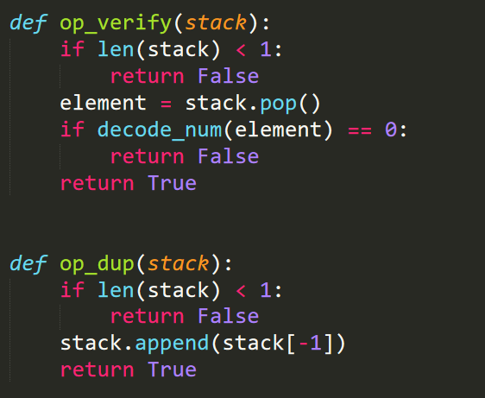
Implementation of Op codes
OP_DUP, OP_VERIFY
Always manipulate the stack!!!

Slide 6
Implementation of Op codes
OP_DUP, OP_VERIFY

Slide 7
Implementation of Op codes
OP_DUP, OP_VERIFY
Numbers are a bit strange in Script!

Slide 8
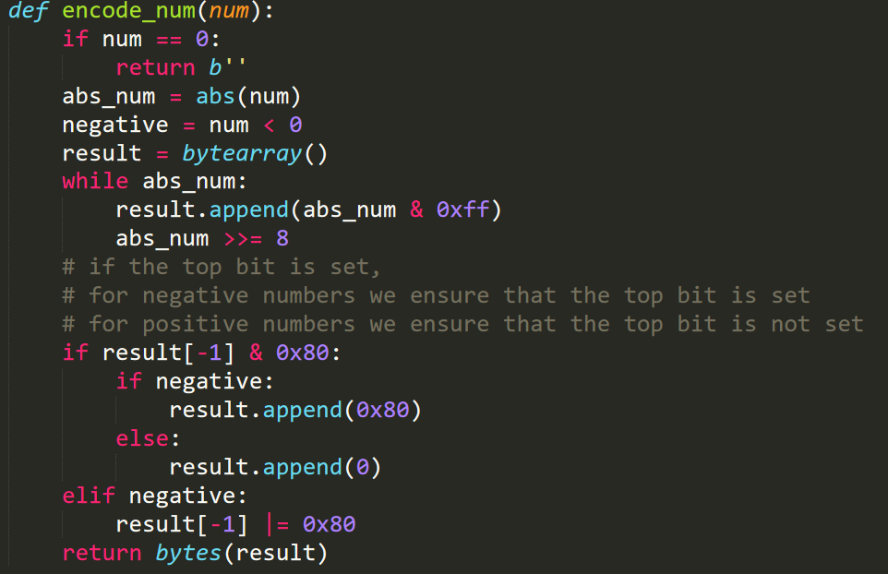
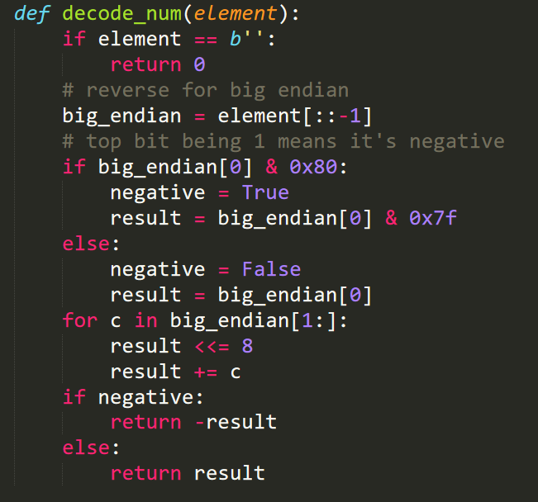
Implementation of Op codes
Numbers in Script

Slide 9
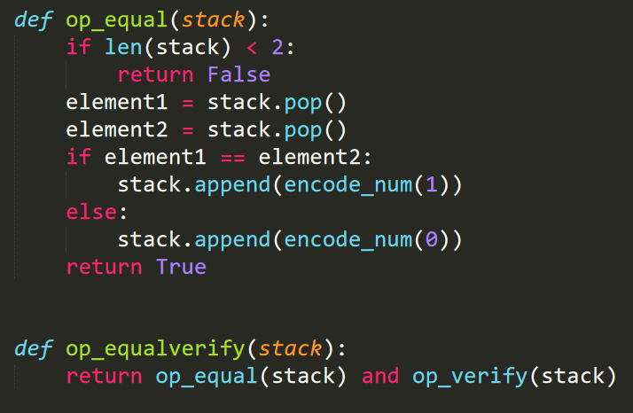
Implementation of Op codes
OP_EQUAL

Slide 10
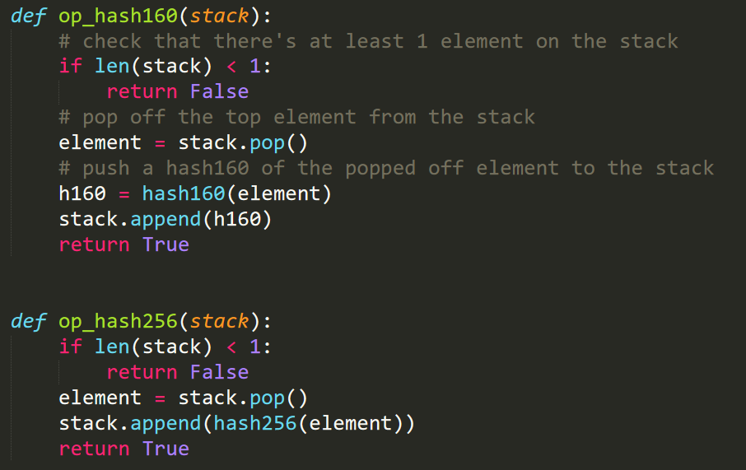
Implementation of Op codes
OP_HASH

Slide 11
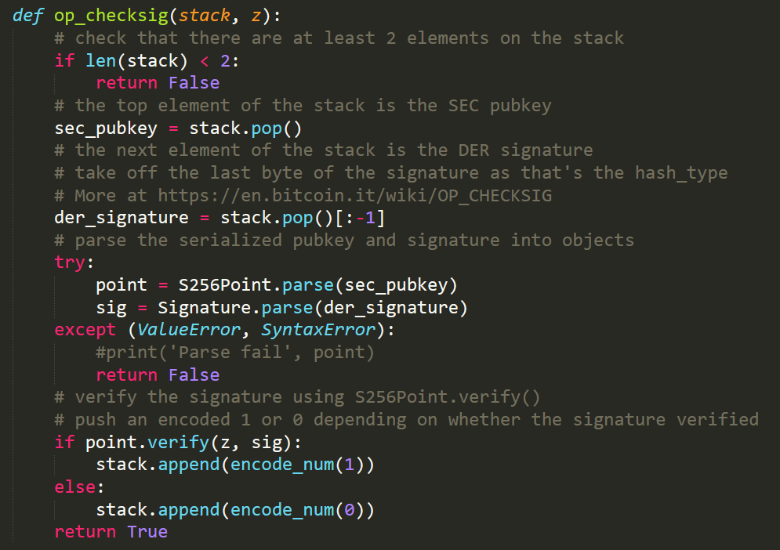
Implementation of Op codes
OP_CHECKSIG

Slide 12
Implementation of Op codes
OP_CHECKSIG
Input: stack, and a hash we need to sign (as int)

Slide 13
Implementation of Op codes
OP_CHECKSIG
When signing in Bitcoin we concatenate the hashType (SIGHASH_ALL) at the end!!!
But only 1 byte!!!

Slide 14

Implementation of Op codes
OP_CHECKSIG

Slide 15
Scripts
Commands
Two types:
OP_CODES
Bytes (data)
How to differentiate which is which?
online.ing.puc.cl

Slide 16
Scripts
Commands
Script = sequence of bytes (when we receive it)
0x00 = OP_0
0x51 = OP_1
…
0x60 = OP_16
0x76 = OP_DUP
0xa9 = OP_HASH160
0xac = OP_CHECKSIG
online.ing.puc.cl

Slide 17
Scripts
Commands
Script = sequence of bytes (when we receive it)
0x00 = OP_0
0x51 = OP_1
…
0x60 = OP_16
0x76 = OP_DUP
0xa9 = OP_HASH160
0xac = OP_CHECKSIG
Read the docs:
https://en.bitcoin.it/wiki/Script
online.ing.puc.cl

Slide 18
Scripts
A jump between 0 and 1!!!
This is were the data goes
Commands
Script = sequence of bytes (when we receive it)
0x00 = OP_0
0x51 = OP_1
…
0x60 = OP_16
0x76 = OP_DUP
0xa9 = OP_HASH160
0xac = OP_CHECKSIG
Read the docs:
https://en.bitcoin.it/wiki/Script
online.ing.puc.cl

Slide 19
Scripts
Data
Script = sequence of bytes (when we receive it)
If I read a byte n between 0x01 and 0x4b, the next n bytes are data
For instance, a DER signature
A SEC public key
A redeem script (for P2SH)
online.ing.puc.cl

Slide 20
Scripts
Data
Script = sequence of bytes (when we receive it)
If I read a byte n between 0x01 and 0x4b, the next n bytes are data
For instance, a DER signature – 70 bytes
A SEC public key – 33/65 bytes
A redeem script (for P2SH) -- ???
online.ing.puc.cl

Slide 21
Scripts
Data
Script = sequence of bytes (when we receive it)
If I read a byte n between 0x01 and 0x4b, the next n bytes are data
For instance, a DER signature – 70 bytes
A SEC public key – 33/65 bytes
A redeem script (for P2SH)
OP_DUP OP_HASH160 <hash> OP_EQUALVERIFY OP_CHECKSIG
Small (24 bytes)
online.ing.puc.cl

Slide 22
Scripts
Data
Script = sequence of bytes (when we receive it)
If I read a byte n between 0x01 and 0x4b, the next n bytes are data
For instance, a DER signature – 70 bytes
A SEC public key – 33/65 bytes
A redeem script (for P2SH)
MULTISIG 5 of 20!!! (20x SEC)
online.ing.puc.cl

Slide 23
Scripts
n = 1 to 75 bytes!!!
Data
Script = sequence of bytes (when we receive it)
If I read a byte n between 0x01 and 0x4b, the next n bytes are data
For instance, a DER signature – 70 bytes
A SEC public key – 33/65 bytes
A redeem script (for P2SH)
MULTISIG 5 of 20!!! (20x SEC)
online.ing.puc.cl

Slide 24
Scripts
n = 1 to 75 bytes!!!
Data
Script = sequence of bytes (when we receive it)
If I read a byte n between 0x01 and 0x4b, the next n bytes are data
For instance, a DER signature – 70 bytes
A SEC public key – 33/65 bytes
A redeem script (for P2SH)
MULTISIG 5 of 20!!! (20x SEC)
75 bytes
What now?
online.ing.puc.cl

Slide 25
Scripts
Data
Script = sequence of bytes (when we receive it)
If I read 0x4c = 76 = OP_PUSHDATA1 -- next byte = length of data
0x4c 0xff <data of length 255 bytes> – from 75 to 255 bytes
If I read 0x4d = 77 = OP_PUSHDATA2 -- next 2 bytes = length
0x4d b1 b2 <data of length 520 bytes> – from 256 to 520 bytes
online.ing.puc.cl

Slide 26
Scripts
Data
Is it not 65535?
NO: Max size on the network is 520 bytes!!!
Script = sequence of bytes (when we receive it)
If I read 0x4c = 76 = OP_PUSHDATA1 -- next byte = length of data
0x4c 0xff <data of length 255 bytes> – from 75 to 255 bytes
If I read 0x4d = 77 = OP_PUSHDATA2 -- next 2 bytes = length
0x4d b1 b2 <data of length 520 bytes> – from 256 to 520 bytes
online.ing.puc.cl

Slide 27
Scripts
Data
Script = sequence of bytes (when we receive it)
0x4c = 76 = OP_PUSHDATA1: from 75 to 255 bytes
0x4d = 77 = OP_PUSHDATA2: from 256 to 520 bytes
0x4e = OP_PUSHDATA4: length 4 bytes; not currently in use
online.ing.puc.cl

Slide 28
Scripts
Commands
Two types:
OP_CODES
Bytes (data)
What now?
Parse (bytes)
Serialize (to bytes)
online.ing.puc.cl

Slide 29
Scripts
Parse
b'\x76\xa9\x14\xf3\xa9\x9f3\x92\xf0\xd4\xa8\xd8|\x05\x84\x135\xd9\xf6l\x1a\xe3,\x88\xac'
76 a9 14 f3a99f3392f0d4a8d87c05841335d9f66c1ae32c 88 ac
OP_DUP OP_HASH160 20 f3a99f3392f0d4a8d87c05841335d9f66c1ae32c OP_EQUALVERIFY OP_CHECKSIG
bytes
hex
ops
online.ing.puc.cl

Slide 30
Scripts
Parse
b'\x76\xa9\x14\xf3\xa9\x9f3\x92\xf0\xd4\xa8\xd8|\x05\x84\x135\xd9\xf6l\x1a\xe3,\x88\xac'
76 a9 14 f3a99f3392f0d4a8d87c05841335d9f66c1ae32c 88 ac
OP_DUP OP_HASH160 20 f3a99f3392f0d4a8d87c05841335d9f66c1ae32c OP_EQUALVERIFY OP_CHECKSIG
bytes
hex
ops
Only for visualization!
online.ing.puc.cl

Slide 31
Scripts
Parse
b'\x76\xa9\x14\xf3\xa9\x9f3\x92\xf0\xd4\xa8\xd8|\x05\x84\x135\xd9\xf6l\x1a\xe3,\x88\xac'
76 a9 14 f3a99f3392f0d4a8d87c05841335d9f66c1ae32c 88 ac
OP_DUP OP_HASH160 20 f3a99f3392f0d4a8d87c05841335d9f66c1ae32c OP_EQUALVERIFY OP_CHECKSIG
bytes
hex
ops
This is used in practice!
online.ing.puc.cl

Slide 32
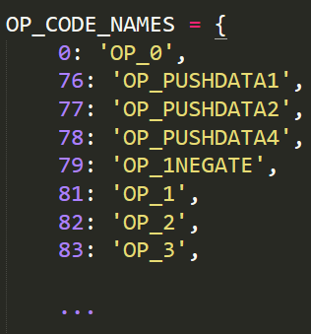
Scripts
Parse
b'\x76\xa9\x14\xf3\xa9\x9f3\x92\xf0\xd4\xa8\xd8|\x05\x84\x135\xd9\xf6l\x1a\xe3,\x88\xac'
76 a9 14 f3a99f3392f0d4a8d87c05841335d9f66c1ae32c 88 ac
OP_DUP OP_HASH160 20 f3a99f3392f0d4a8d87c05841335d9f66c1ae32c OP_EQUALVERIFY OP_CHECKSIG
bytes
hex
ops
This is used in practice!
online.ing.puc.cl

Slide 33
Scripts
Parse
Serializations starts with the length of the script (varint)
19 76 a9 14 f3a99f3392f0d4a8d87c05841335d9f66c1ae32c 88 ac
OP_DUP OP_HASH160 20 f3a99f3392f0d4a8d87c05841335d9f66c1ae32c OP_EQUALVERIFY OP_CHECKSIG
25 (hex)
online.ing.puc.cl

Slide 34
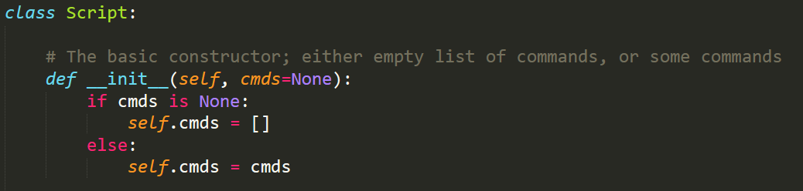
Scripts
Parse
online.ing.puc.cl

Slide 35
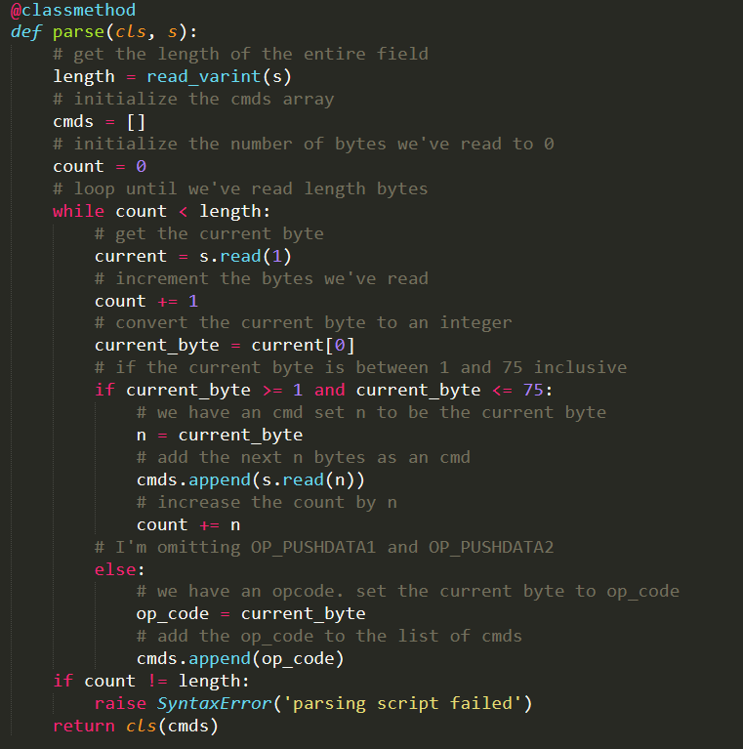
Scripts
Parse
online.ing.puc.cl

Slide 36
Scripts
Serialize
ops
OP_DUP OP_HASH160 20 f3a99f3392f0d4a8d87c05841335d9f66c1ae32c OP_EQUALVERIFY OP_CHECKSIG
76 a9 14 f3a99f3392f0d4a8d87c05841335d9f66c1ae32c 88 ac
19 76 a9 14 f3a99f3392f0d4a8d87c05841335d9f66c1ae32c 88 ac
hex
Length
online.ing.puc.cl

Slide 37
Scripts
Serialize
76 a9 14 f3a99f3392f0d4a8d87c05841335d9f66c1ae32c 88 ac
\x19 \x76 \xa9 \x14 f3a99f3392…
hex
bytes
In reality!
online.ing.puc.cl

Slide 38
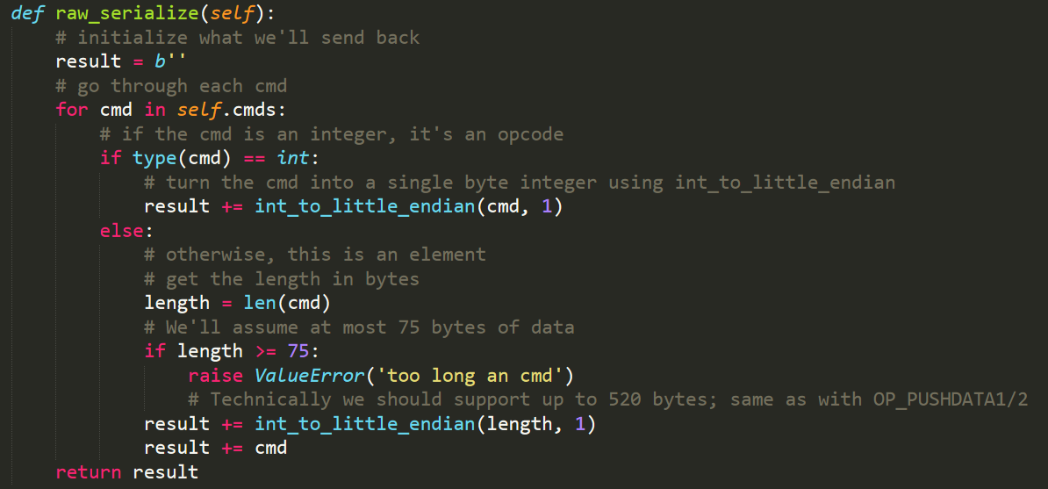
Scripts
Serialize
online.ing.puc.cl

Slide 39
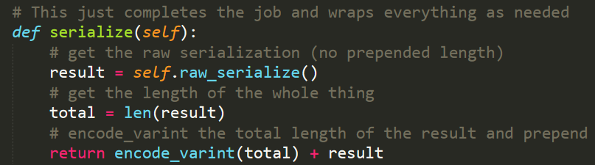
Scripts
Serialize
online.ing.puc.cl

Slide 40
Scripts
Evaluate
What are we missing?
We need to execute Script
How to do this?
Command by command using the stack
online.ing.puc.cl

Slide 41
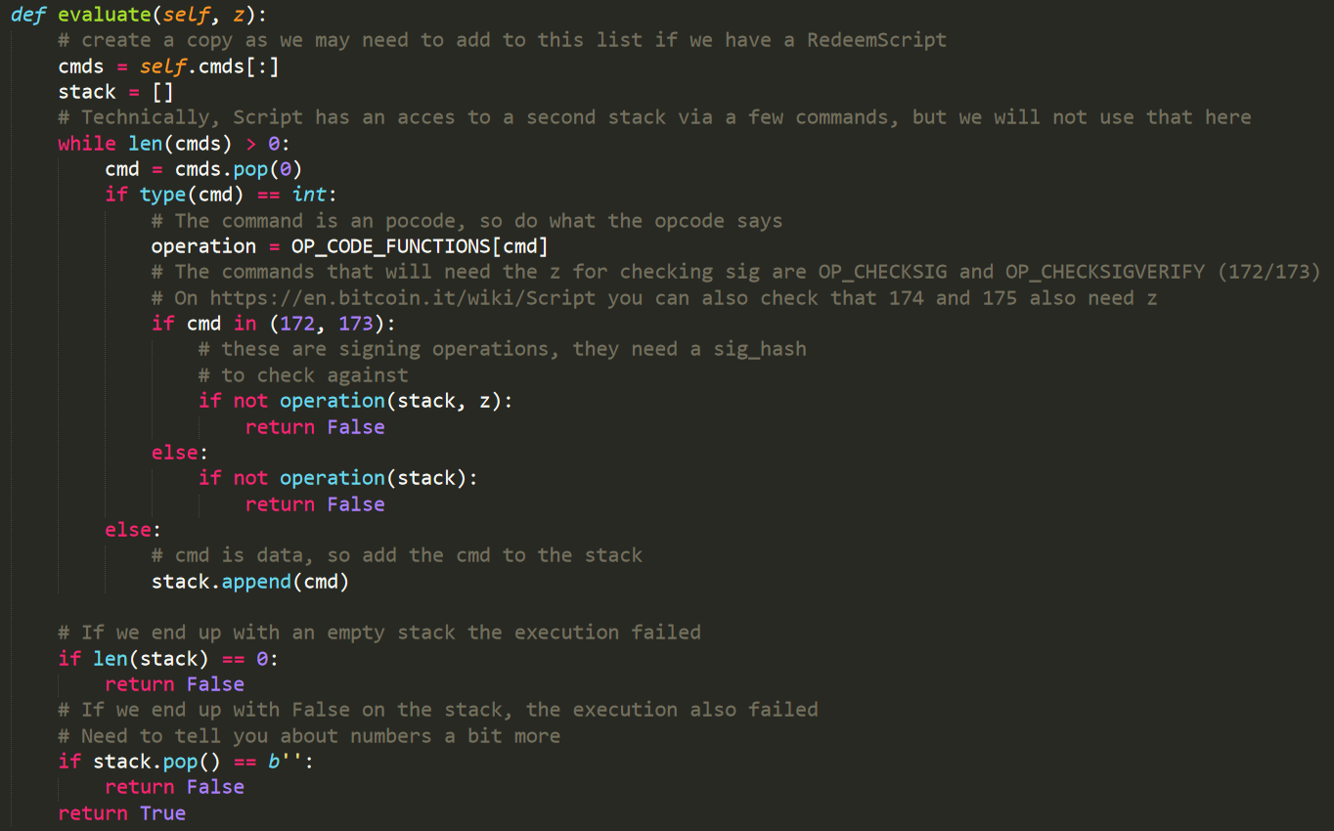
Scripts
Evaluate
online.ing.puc.cl

Slide 42
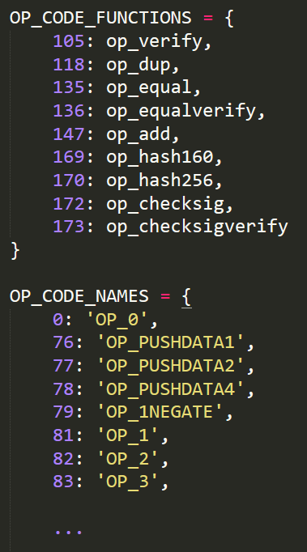
Scripts
In op.py
Evaluate
online.ing.puc.cl

Slide 43
Scripts
Evaluate
sig_hash
i.e. What we sign
online.ing.puc.cl

Slide 44
Scripts
Evaluate
CHECKSIG uses z!!!
online.ing.puc.cl

Slide 45
Scripts
Evaluate
Only for P2SH
online.ing.puc.cl

Slide 46
Scripts
Evaluate
Stack.init()
We don’t implement altstack
online.ing.puc.cl

Slide 47
Scripts
Evaluate
Execution continues while we have commands to execute
online.ing.puc.cl

Slide 48
Scripts
Evaluate
The command OPcode
online.ing.puc.cl

Slide 49
Scripts
Evaluate
What function will we use?
online.ing.puc.cl

Slide 50
Scripts
Evaluate
For CHEKCSIG we need to pass the hash as an argument in addition to the stack
online.ing.puc.cl

Slide 51
Scripts
Evaluate
Other commands need only the stack!!!
online.ing.puc.cl

Slide 52
Scripts
Evaluate
If cmd is not a command it is data!
online.ing.puc.cl

Slide 53
Scripts
Evaluate
At the end, the stack can not be empty!
online.ing.puc.cl

Slide 54
Scripts
Evaluate
At the end, the stack can not contain False!
online.ing.puc.cl

Slide 55
Scripts
Evaluate
Successfull execution!
online.ing.puc.cl

Slide 56
Scripts
Evaluate
We do not implement:
IF/ELSE
Altstack
MULTISIG
online.ing.puc.cl

Slide 57
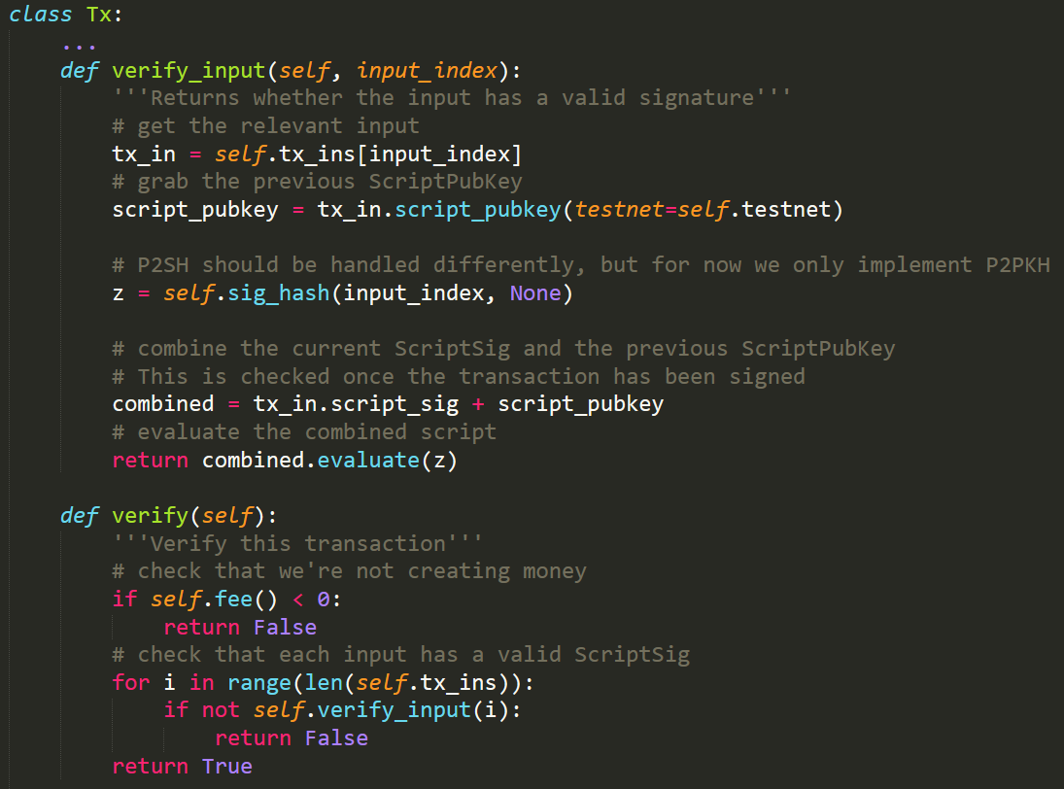
Scripts
Verification
online.ing.puc.cl

Slide 58
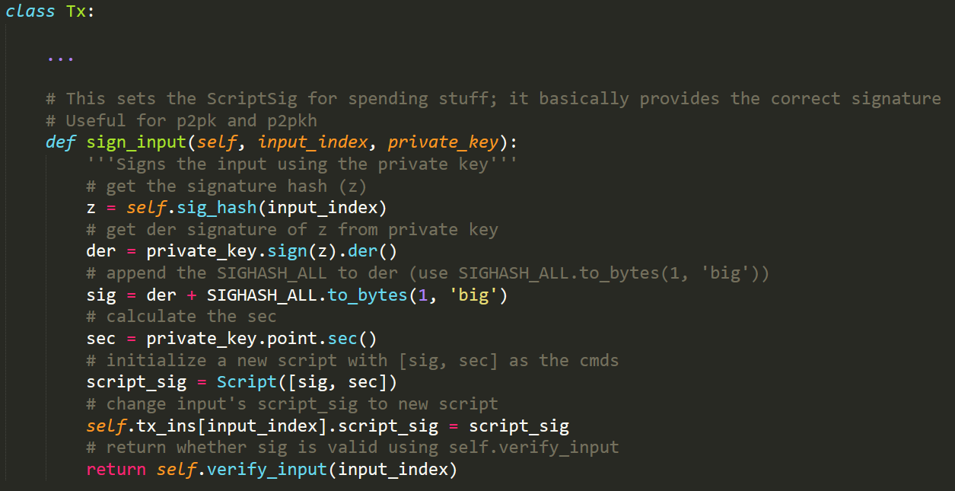
Scripts
Signing
online.ing.puc.cl

Slide 59
Spending money
How do I spend my bitcoins?
An address is a public key?
What is an address used for?
How do I find my bitcoins?
Waaaaa!!!
online.ing.puc.cl

Slide 60
Spending money
How do I spend my bitcoins?
An address is a public key? – only for P2PK
What is an address used for?
How do I find my bitcoins?
Waaaaa!!!
online.ing.puc.cl

Slide 61
Spending money
How do I spend my bitcoins?
An address is a public key? – only for P2PK
What is an address used for? – P2PKH, P2SH
How do I find my bitcoins?
Waaaaa!!!
online.ing.puc.cl

Slide 62
Spending money
How do I spend my bitcoins?
An address is a public key? – only for P2PK
What is an address used for?
How do I find my bitcoins? – You already know (full node)
Waaaaa!!!
online.ing.puc.cl

Slide 63
Spending money
How do I spend my bitcoins?
An address is a public key? – only for P2PK
What is an address used for?
How do I find my bitcoins? – You already know (full node)
Waaaaa!!! – OK, I’ll make your life a bit easier!
online.ing.puc.cl

Slide 64
Spending money
How do I spend my bitcoins?
An address is a public key? – only for P2PK
What is an address used for?
How do I find my bitcoins? – You already know (full node)
Waaaaa!!! – OK, I’ll make your life a bit easier!
I’ll send you a script!!!
Which script?
online.ing.puc.cl

Slide 65
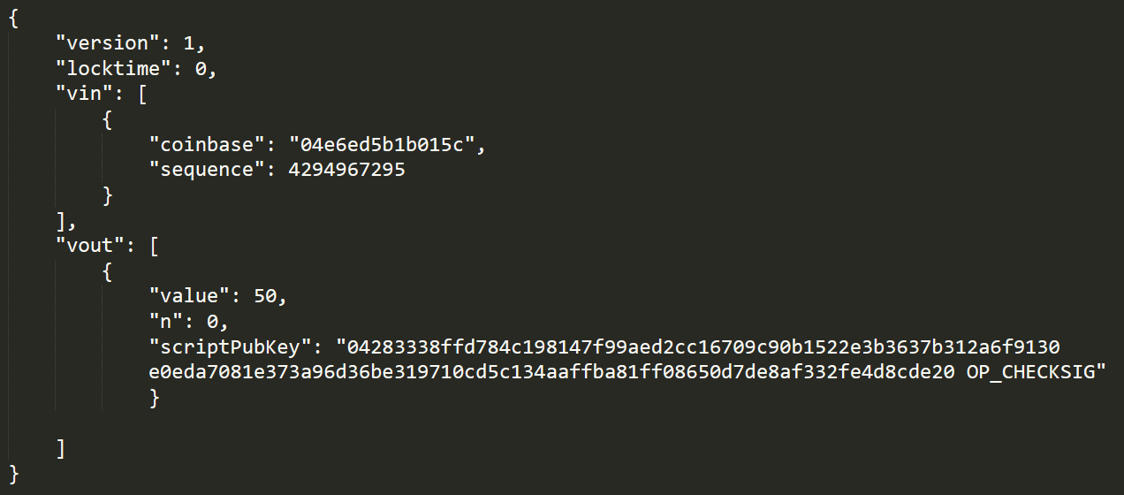
Addresses
P2PK
online.ing.puc.cl

Slide 66
Addresses
P2PK
ECC key SEC (uncompressed)
online.ing.puc.cl

Slide 67
Addresses
P2PK
CHECKSIG
online.ing.puc.cl

Slide 68
Addresses
P2PK
Where do we send the money?
online.ing.puc.cl

Slide 69
Addresses
To my public key in SEC
P2PK
Where do we send the money?
online.ing.puc.cl

Slide 70
Addresses
To my public key in SEC
Script: SEC + OP_CHECKSIG
P2PK
Where do we send the money?
online.ing.puc.cl

Slide 71
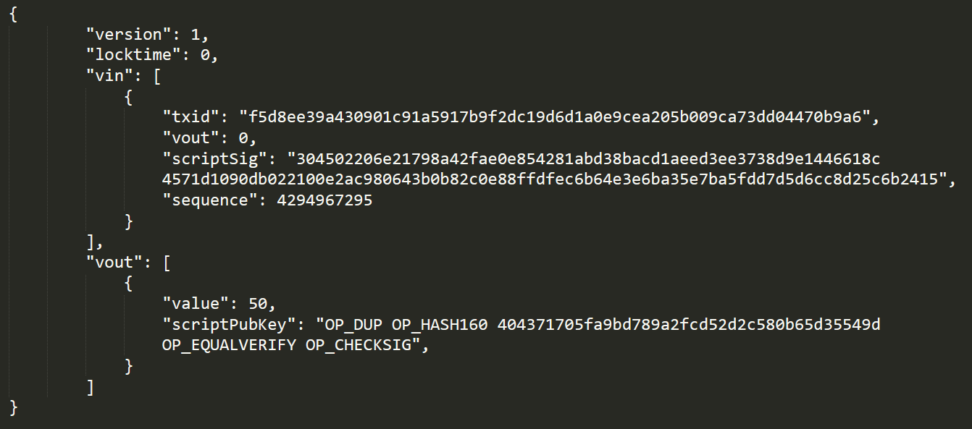
Addresses
P2PKH
Where do we send the money?
To a P2PKH script
online.ing.puc.cl

Slide 72
Addresses
How do we specify this??
With my address!
P2PKH
Where do we send the money?
To a P2PKH script
online.ing.puc.cl

Slide 73
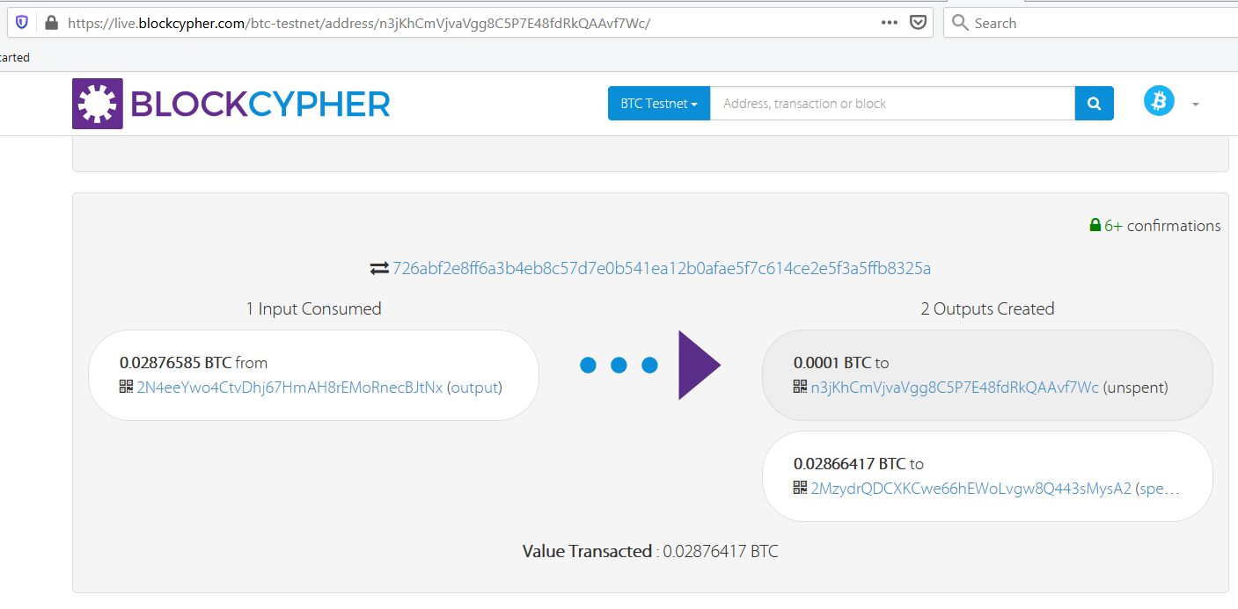
Addresses
P2PKH
Sending BTC to our address
online.ing.puc.cl

Slide 74
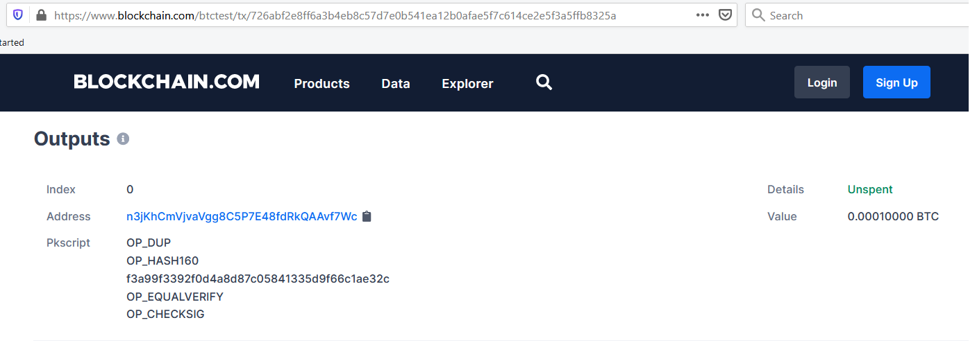
Addresses
P2PKH
???????
online.ing.puc.cl

Slide 75
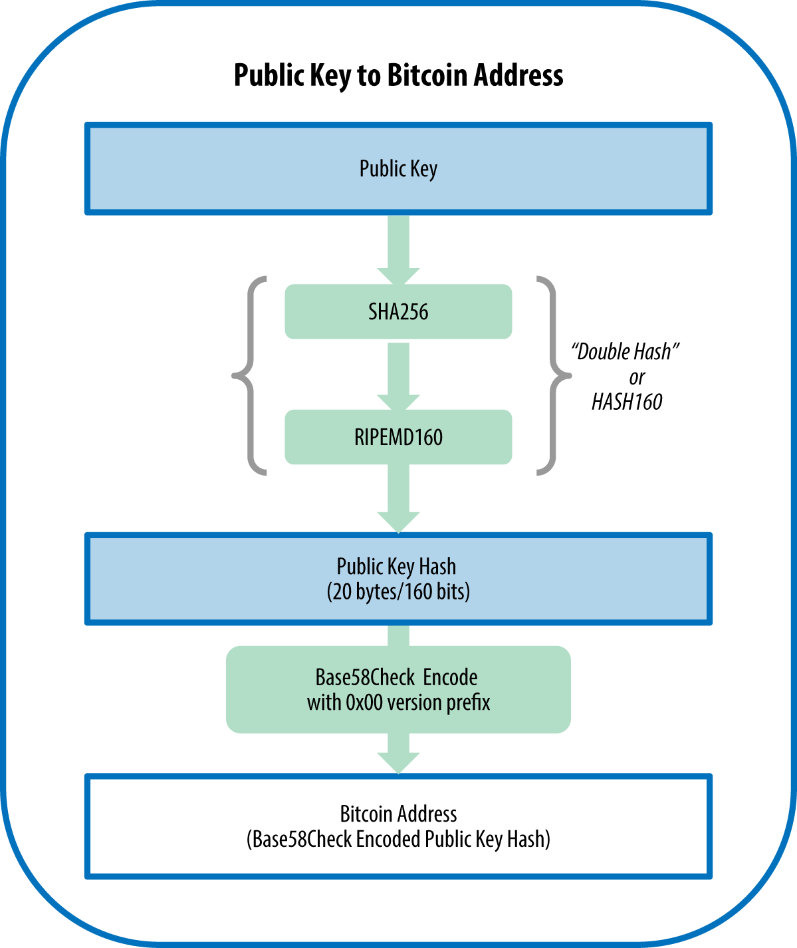
A Bitcoin address
Is not a public key
https://github.com/bitcoinbook/bitcoinbook/blob/develop/ch04.asciidoc

Slide 76
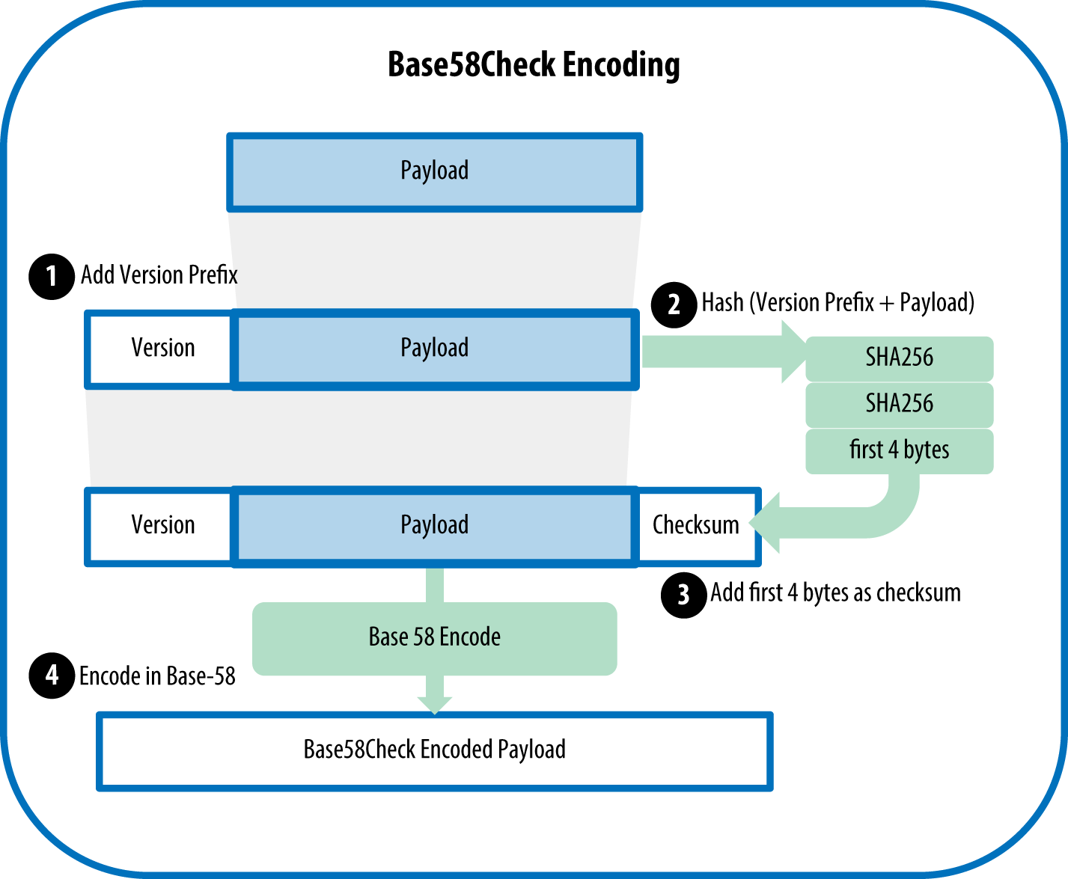
A Bitcoin address
Is not a public key
https://github.com/bitcoinbook/bitcoinbook/blob/develop/ch04.asciidoc

Slide 77
Addresses in BitCoin
For P2PKH!!!
P a public key in SEC format
How do we get the Bitcoin address?
version = 0x00 for mainnet, y 0x6f for testnet
key = ripemd160(sha256(P))
checksum = sha256(sha256(version + key))[:4]
res = version + key + checksum
Return encode_base58(res):
Produces a sequence starting with 1 (mainnet), or m/n (testnet)
This prefix tells me what type of address this is!
https://en.bitcoin.it/wiki/List_of_address_prefixes
online.ing.puc.cl

Slide 78
Addresses in BitCoin
For P2PKH!!!
An address with the prefix 0x00 or 0x6f (1,m,n in base58):
Tells me: pay me to a P2PKH
OP_DUP OP_HASH160 <hash> OP_EQUALVERIFY OP_CHECKSIG
To which <hash>?
D my address P2PKH
Convert D from base 58 to bytes
Remove the prefix
Remove the checksum
The result is my <hash>
online.ing.puc.cl

Slide 79
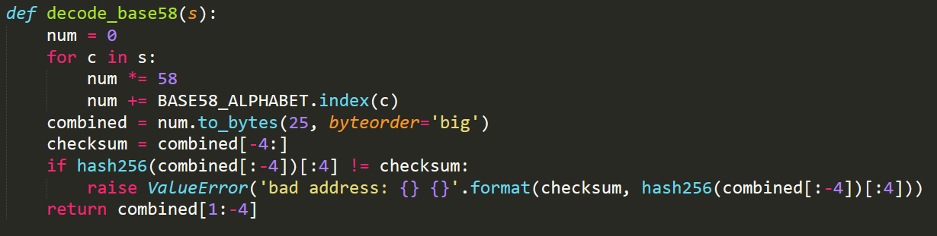
Addresses in BitCoin
For P2PKH!!!
Verify checksum
Remove prefix and checksum
online.ing.puc.cl

Slide 80
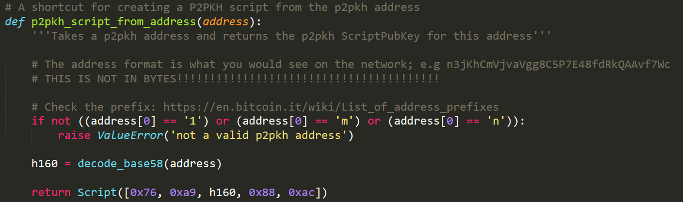
Addresses in BitCoin
For P2PKH!!!
An address with the prefix 0x00 or 0x6f (1,m,n in base58):
Tells me: pay me to a P2PKH
OP_DUP OP_HASH160 <hash> OP_EQUALVERIFY OP_CHECKSIG
This will be the scriptPubKey to which we pay!!!
online.ing.puc.cl

Slide 81
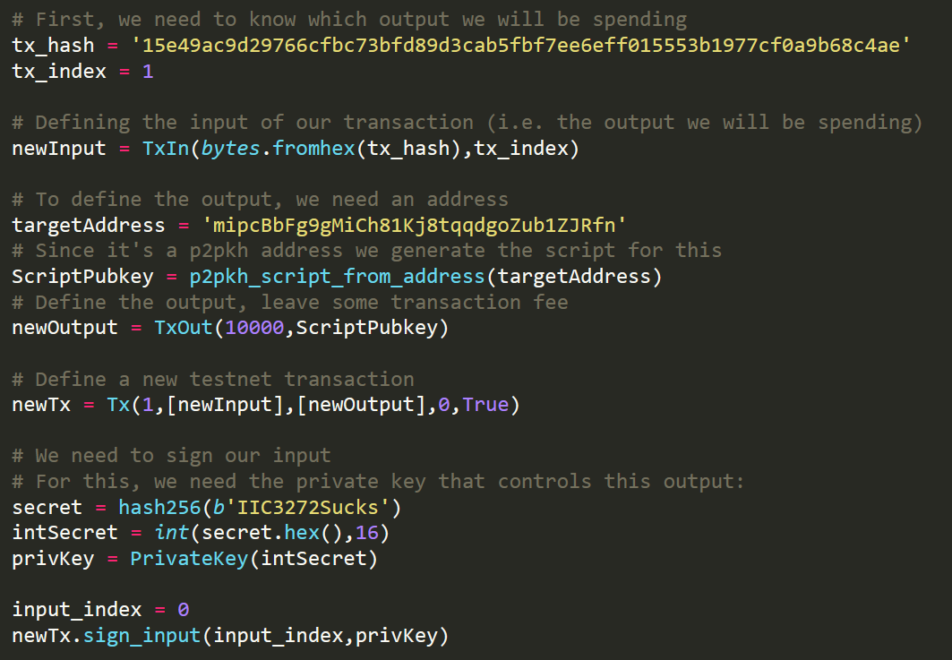
Spending money
P2PKH
I need to know what am I spending!
online.ing.puc.cl

Slide 82
Spending money
P2PKH
Define this input!
online.ing.puc.cl

Slide 83
Spending money
P2PKH
Who am I paying to?
online.ing.puc.cl

Slide 84
Spending money
P2PKH
I have my TX!
online.ing.puc.cl

Slide 85
Spending money
P2PKH
I sign my inputs!
online.ing.puc.cl

Slide 86

Spending money
P2PKH
This is what I broadcast to the network!!!
online.ing.puc.cl

Slide 87
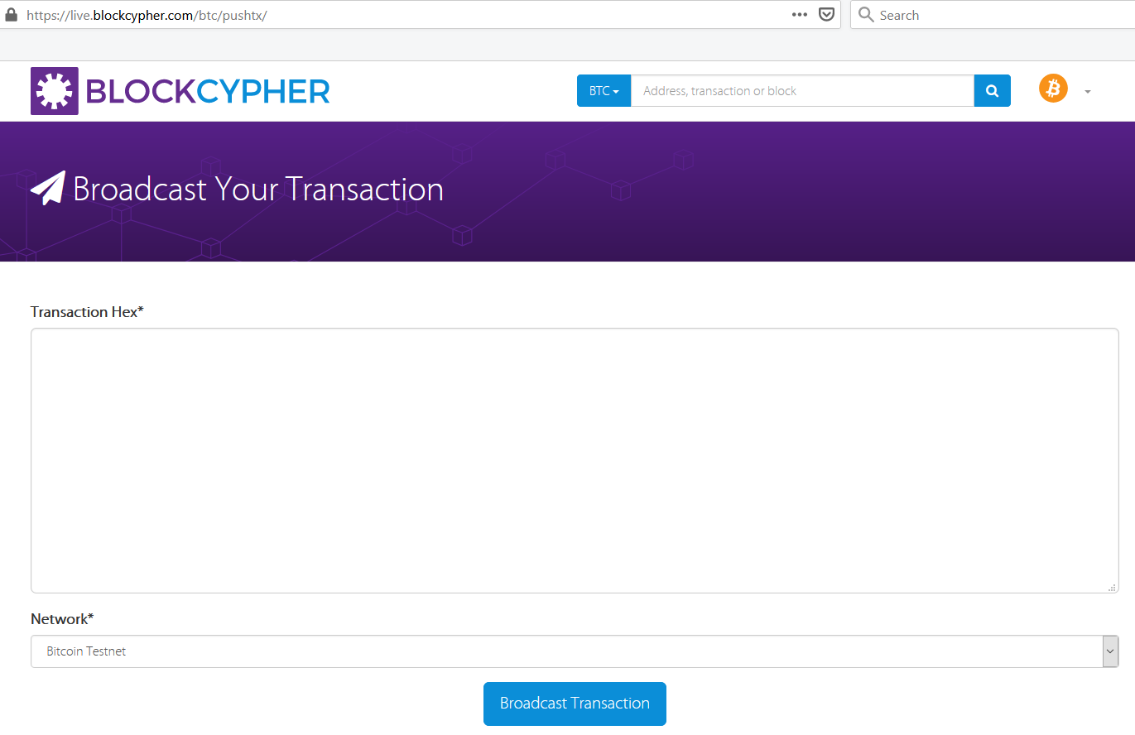
Spending money
P2PKH
online.ing.puc.cl

Slide 88
Addresses
P2SH
An address with the prefix 0x05 or 0xce (3,2 in base58):
Tell me: pay me a P2SH
OP_HASH160 <hash> OP_EQUAL
To which <hash>?
D my P2SH address
Convert D from base 58 to bytes
Remove the prefix
Remove the checksum
The result is my <hash>
online.ing.puc.cl

Slide 89
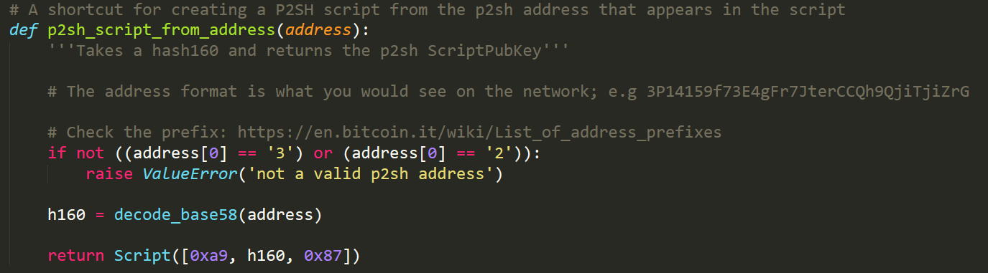
Addresses
P2SH
An address with the prefix 0x05 or 0xce (3,2 in base58 mainnet/testnet):
Tell me: pay me a P2SH
OP_HASH160 <hash> OP_EQUAL
Pay to this script:
online.ing.puc.cl

Slide 90
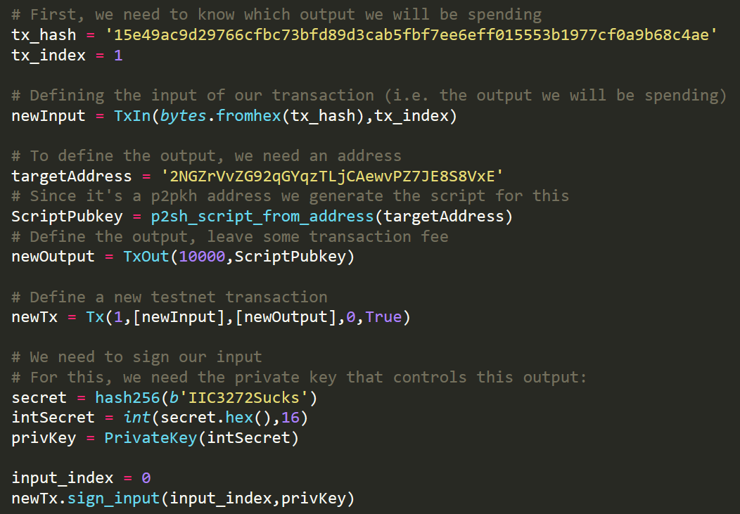
Spending money
P2SH
This is how i pay to a P2SH!
online.ing.puc.cl

Slide 91
Addresses
P2SH
How to generate a P2SH address?
From my redeem script (its serialization in bytes)
I need to have my redeem script!!! (o be able to reconstruct it)
How to spend my P2SH output?
With the redeem script
And with the unlocking script for this redeem script
The signature is different (scriptSig is rplaced by the redeem script)
Let’s see this in detail!
online.ing.puc.cl

Slide 92
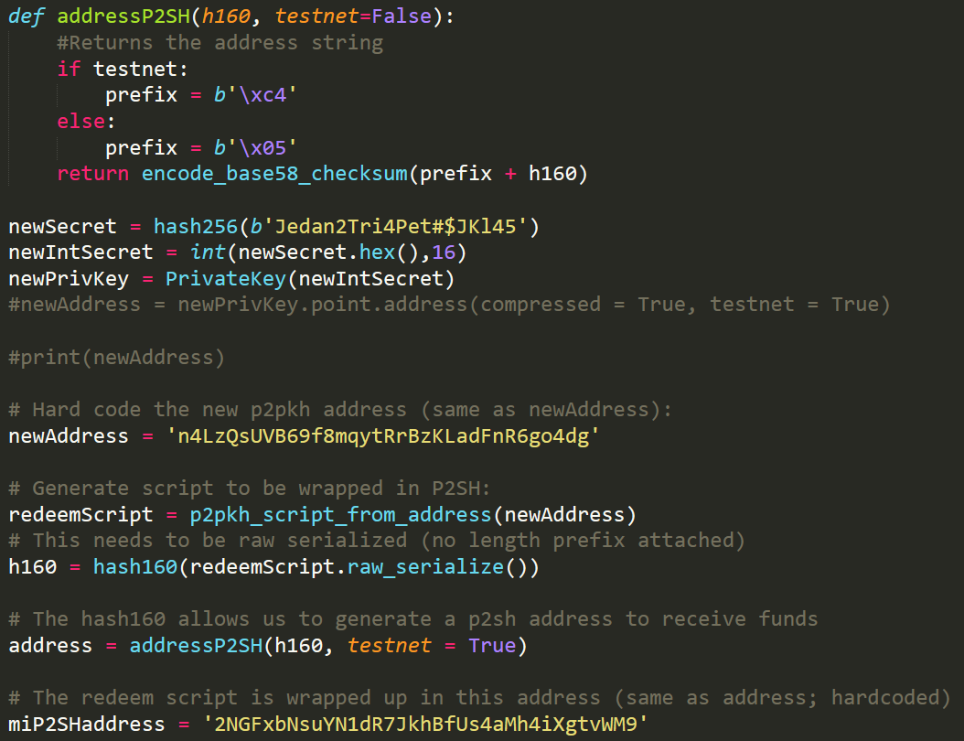
Generating a P2SH address
How to generate a P2SH address?
This generates an address from a h160
online.ing.puc.cl

Slide 93
Generating a P2SH address
How to generate a P2SH address?
First we generate the redeem script
online.ing.puc.cl

Slide 94
Generating a P2SH address
How to generate a P2SH address?
With this we generate a P2SH address
online.ing.puc.cl

Slide 95
Generating a P2SH address
How to generate a P2SH address?
IMPORTANT: raw_serialize()
i.e. without len(script)
online.ing.puc.cl

Slide 96
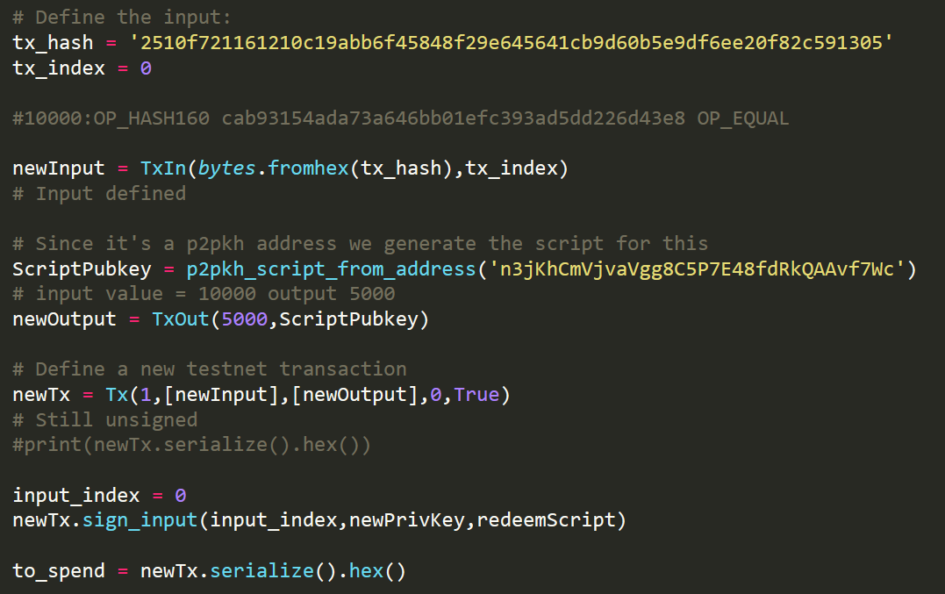
Spend a P2SH output
Output that is spent
online.ing.puc.cl

Slide 97
Spend a P2SH output
Pay to a P2PKH
online.ing.puc.cl

Slide 98
Spend a P2SH output
Signing my P2SH spend!!!
online.ing.puc.cl

Slide 99
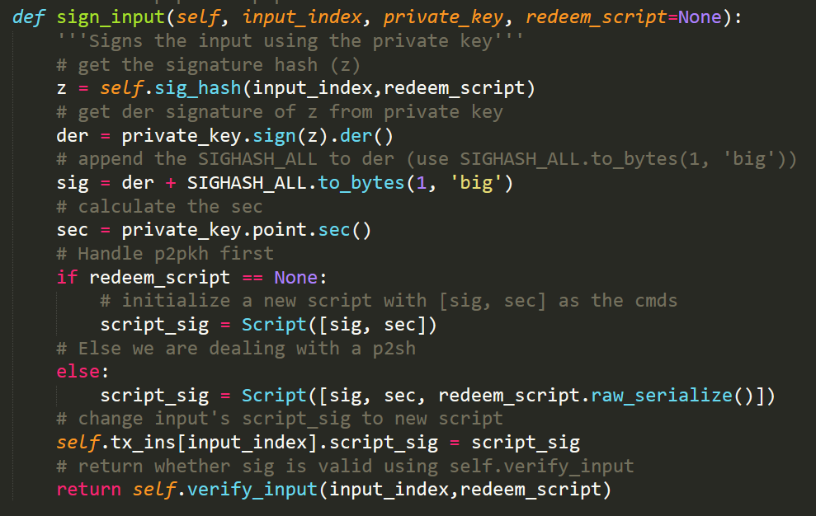
Spend a P2SH output
P2PKH
online.ing.puc.cl

Slide 100
Spend a P2SH output
P2SH
online.ing.puc.cl

Slide 101
Spend a P2SH output
Careful: for P2SH I also need the redeem_script
online.ing.puc.cl

Slide 102
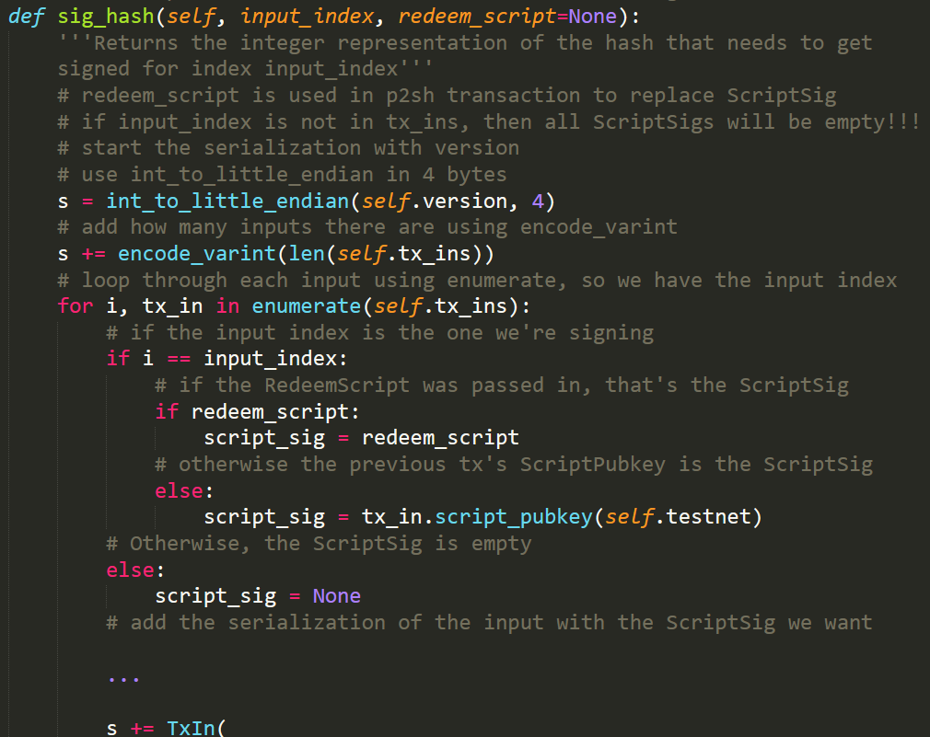
Spend a P2SH output
For P2SH ScriptSig is replaced by redeem_script
online.ing.puc.cl

Slide 103
Important
P2SH
The methods we have in tx.py allow us to:
Create a P2SH spend
The methods we have in tx.py do **not** allow us:
To validate a P2SH script (correctly)
If you are bothered with this you can implement this in full!!!
online.ing.puc.cl

Slide 104
References
Jimmy Song, Programming Bitcoin, chapters 5,6,7,8
https://en.bitcoin.it/wiki/Script
https://en.bitcoin.it/wiki/OP_CHECKSIG
https://bitcoin.stackexchange.com/questions/3374/how-to-redeem-a-basic-tx
online.ing.puc.cl

